Slide 1
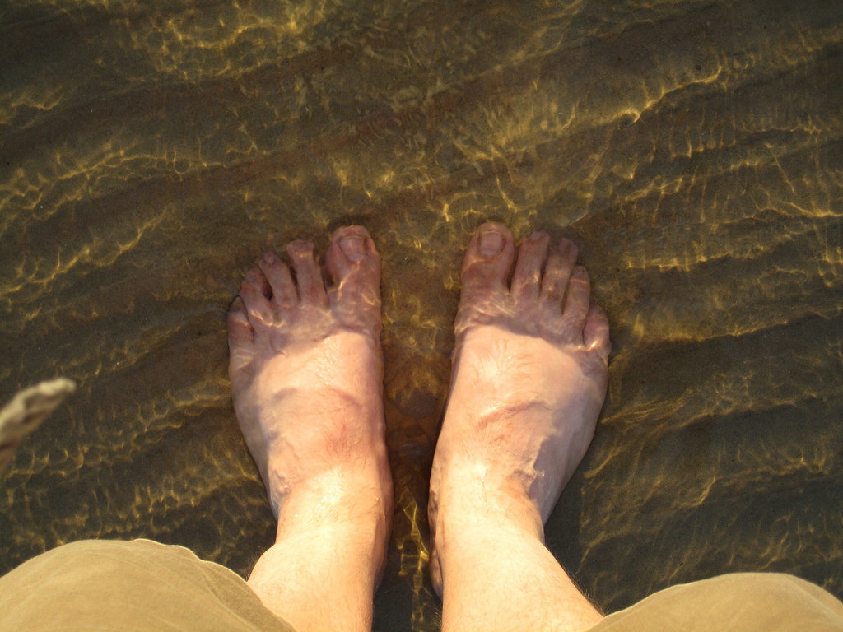
Toes in the Water
Getting your feet wet with a WordPress blog
photo credit: <a href="http://www.flickr.com/photos/49503168860@N01/4847354993">40+274 Beach</a> via <a href="http://photopin.com">photopin</a> <a href="https://creativecommons.org/licenses/by/2.0/">(license)</a>

Slide 2
Nancy Kay Grace
Speaker, Author, Blogger, Internet Radio Host
www.nancykaygrace.com
Minimizing the fear factor
for tech challenged writers

Slide 3
WordPress.com or Wordpress.org?
WordPress.com – takes care of all the hosting for you. You don’t have to download software, pay for hosting, or manage a web server.
You cannot customize your site plugins, limited themes are available, sometimes they show ads on your site.
WordPress.org – is self-hosted, meaning your purchase a domain name, buy a hosting plan and install WordPress software.
You have total control over the look and feel of the website and can add plugins to customize its functionality.

Slide 4
PURPOSE
Identify the purpose of your blog
Topic
What are you passionate about?
What topic do you have knowledge about?
Objective
What do you want to accomplish?

Slide 5
Getting Started
Pick a domain name.
This is the “house” where you will build your website content and blog.
Choose a web hosting company.
This is the “land” where your files and content are stored.
Choose a theme for your website. This template creates the overall design or “look” for your site.

Slide 6
Effective Online Writing
Search Engine Optimization (SEO) helps your content get found in the mass of information on the web.
Effective layout helps search engines identify your content.
People’s online reading habits influence online writing.

Slide 7
How Search Engines Work
Search engines, like Google, use electronic robots (“bots” or “spiders”) to scan or “crawl” the internet constantly.
Each of your WP pages and post have a unique web address (URL).
The bots gather information from every web page and organizes it.
The information is filed and stored so that when someone searches for a topic, it can be found quickly.

Slide 8
Search Engine Optimization (SEO) and the Blogger
SEO is for search engines.
The blogger chooses keywords to identify the topic of your blog posts
Search engines will discover your keywords and list your content when someone types in those keywords to search for a topic.

Slide 9
Keywords
Keyword is the main topic of your post
Include the Keyword
in the title
in first sentence
Throughout your content
In headings
In the URL in meta description of the blog post

Slide 10
Categories & Tags
Every post must have a category and optional tags. Assign them in the right column of the Admin panel.
They sort your content by topic.
Categories
Help search engines through broad grouping of blog content. They are like the table of contents.
Tags
Help search engines through specific details and keywords that apply to the specific post. They are like the index at the back of a book.

Slide 11
Tips for Online Writing
Write content that is easy to skim and scan.
Start with your conclusion
Make every paragraph short.
Use meaningful Headings (H1, H2…)
Use bullet points and lists

Slide 12
Adding Images
Reading text alone can be boring.
Add visual interest with photos
Search Engines only read text.
Optimize the photo – rename the image with the keyword, use ALT Text

Slide 13
Tips for Images
Use images legally. Give proper attribution.
Find free stock photos as public domain sites.
Pixabay, Morguefile,Unsplash, Gratisography, Photopin
Customize the photo using Picmonkey or Canva.
Add text and effects

Slide 14
Adding Links
Use the hyperlink tool instead of writing out the actual link.
Hyperlinks take the reader to other information and websites you mention in your post
Link to your own blog posts or website pages if you have more on the topic
Benefits of adding hyperlinks
increase your SEO
enhance your credibility

Slide 15
Ready to Dive In?
photo credit: <a href="http://www.flickr.com/photos/98193606@N00/3434945430">Testing the waters</a> via <a href="http://photopin.com">photopin</a> <a href="https://creativecommons.org/licenses/by/2.0/">(license)</a>

Slide 16
Creating a Blog Post
Choose your topic / decide on keyword
Create a title using the keyword. This will appear in the URL.
Write the main body of content.
300 - 700 words.
Short paragraphs
First paragraph states the point of the post.
Close with a call to action. What do you want the reader to do with this new information?

Slide 17
Dress it Up
Adding Headings (H1, H2, H3) with the Keyword.
Create Blog Header
Add images to the post filling in the alternate text (alt text) with Keyword
Add hyperlinks
Add Categories and tags

Slide 18
Before your Hit “Publish”
Check Yoast checklist for SEO.
Preview and check links.
Check your social media connections so your post will be publicized. Right hand column of Admin panel
Publish! Happy dance!

Slide 19
After you Hit “Publish”
You put time into writing a post, so after it is published, keep sharing it over time.
Ask yourself, “Is there anything I’ve just written that can be used in a follow-up post?”
Continue to share across your social media networks.
Over several weeks, schedule social media posts at different times of day using the key points from your blog.
Take quotes from your post and make eye-catching graphics to share on social media.

Slide 20
Final Thoughts
Good writing always matters.
The best way to learn WordPress is to play around with it. Don’t be afraid of trial & error.
If you are think you’ve crashed your site, call your hosting provider. They have access to backups of your site from the previous 24 hours.
Keep a regular backup of your site.

Slide 21
Stay out of Deep Water
Avoid plagiarism
Represent yourself or your company professionally
Avoid vague or false claims

Slide 22
Resources
Webwisewording.com
Amylynnandrews.com
Bluehost WordPress Walkthrough Video Series
Websitecreationworshop.com
Problogger.com
Michaelhyatt.com
Wpbeginner.com

